Slide 1
Dalvik Virtual Machine
Standard Apps
Application Frameworks
Native Support

Slide 2
Android – purposefully built for Mobile Devices
It is completly PORTABLE to any mobile device
Android is built on top of Linux kernel

Slide 3
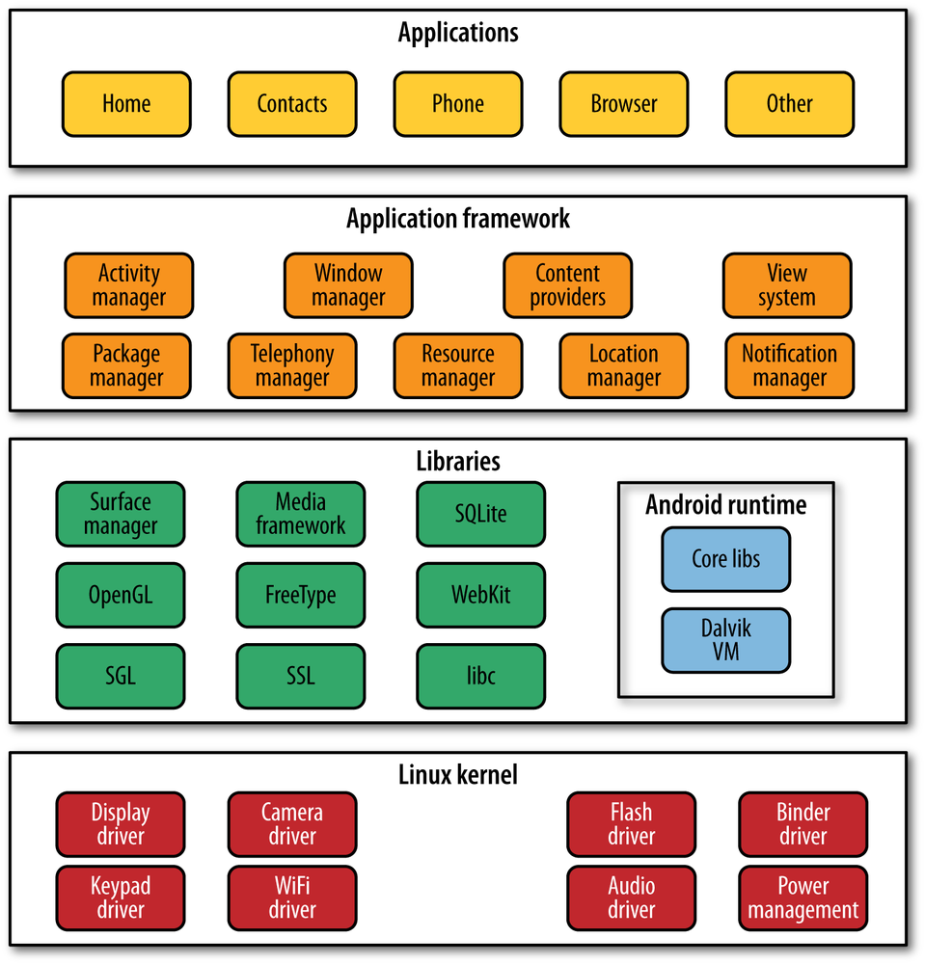

Slide 4
Java Source
Java Class
aapt
(Dalvik VM).dex
XML/Images
.apk
adb
Android Vitural Device

Slide 5
JVM – built for one-size-fits-all solution for ANY machine
Dalvik – built purposfully for Mobile device

Slide 6
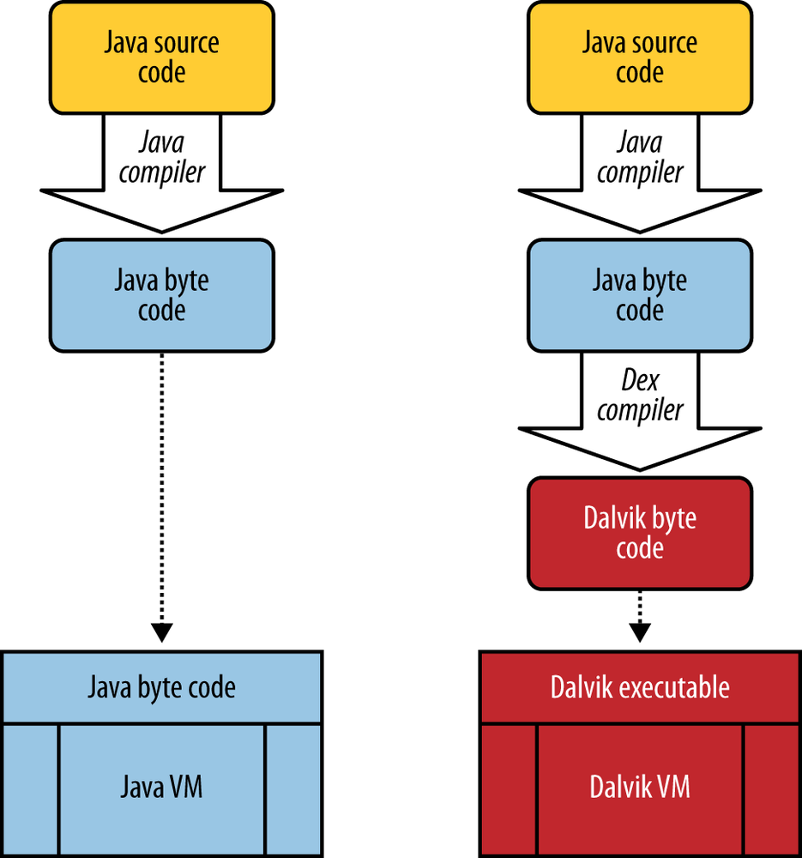

Slide 7
UI Hierarchy
Views
Fragments
Activity
Layout

Slide 8
Dalvik
( it is Virtual m/c runs java android application)
Basic Components in Android
Activity
(just display a window)
Content Provider
Service
Broadcast Receiver

Slide 9
ADT Bundle ( it include Android SDK and its own eclipse platform )
ADT Plugin (it is eclipse PLUGIN )
SDK Manager ( collection different part of android platform )
AVD Manger (it is emulator, to run application )
Dalvik Debug Monitor Server (DDMS) – eclipse prespective
SDK
Manager
SDK Platform Tools
ADT
&
AVD
Android SDK
Android platform

Slide 10
AndroidManifest.xml
Activity( a Java file)
Layout ( a XML file )
UI Components

Slide 11
View
User Interface is in XML
=
User interface is in HTML
Activity
=
servlet
Activity
Activity
Activity
Activity Manager ( as Web-Container )
Android Application Framework

Slide 12
Intent = HTTPSessionContexxt, requst attributes
Content Provider = JDBC
Service = background process
Broadcast receiver = Event Listener

